Slide 1




Digital Tools in Penitentiary Education
Dr Victoria Knight
De Montfort University
vknight@dmu.ac.uk
EPTA Annual Conference
11-13 September 2024
Tbilisi, Georgia
www.europris.org

Slide 2



Overview
Digital Transformation of Prisons
Staff Role in Rehabilitation (with digital)
What we know is needed
What is needed to leverage staff digital education?
Staff as Brokers in Prison Reform
Preparation for Workshop
www.europris.org

Slide 3

Your thoughts…
What are your services’ needs and priorities?
Tell us what digital resources and services are currently deployed in your nation’s service:
For staff
For prisoners
www.europris.org
Notes:
Menti question…
Word cloud….

Slide 4
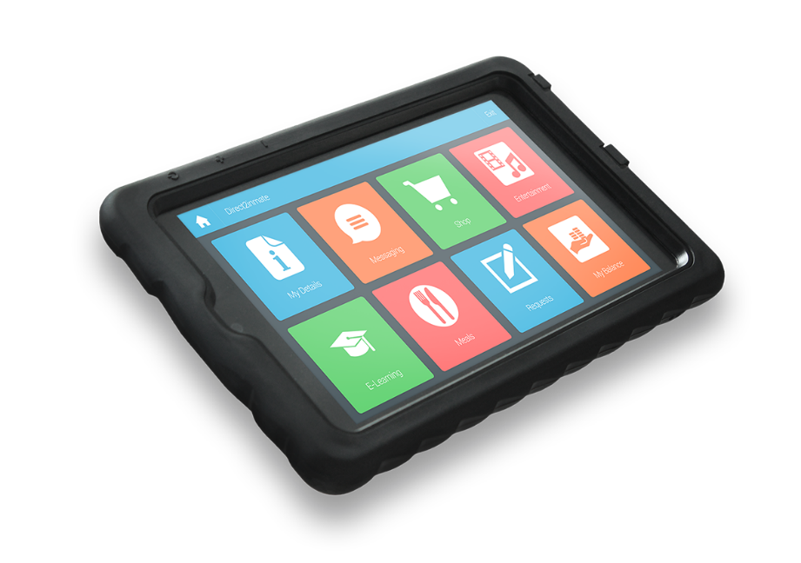
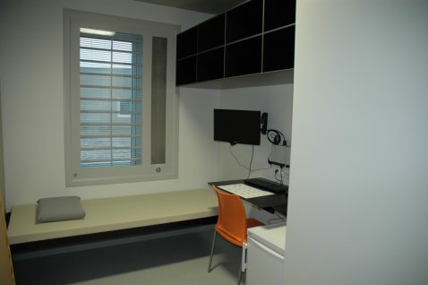
Digital Transformation in Prisons
Strategies – pathways to modernisation
All contact and input leads to rehabilitative opportunities
Moral and ethical drivers
Security
Cost
Skills
Legislative, policy, regulatory frameworks
www.europris.org
Notes:
All these factors impact on a service’s ability to digitally mature.
The position is that all interactions in a prison setting are an important opportunity to undertake and support rehabilitation.
STAFF are key to this endeavour.
Digital is key to this agenda. As outlined in much published research as well as UNICRI’s 2024 report : Digital Rehabilitation in Prisons.
This report stresses the importance of staff in this. As I will discuss later we found that there are significant activities that a required to ensure staff are skilled enough to deal with and support digital change.
When we talk and think about prison we must talk about the ethical and moral drivers of the work and support made available in prisons. If we add digital to this, as we saw from Zvaid’s presentation – it is important to be mindful of this. And reflect on what staff need to learn and understand in this evolving digital landscape.
Practicalities can also be assisted by digital and reflecting on how technology can assist in things like security and public protection, ensure public money is spent responsibly is also important.
Equipping staff with skills is important- but what skills and to what competency levels are required to support rehabilitation?
Having knowledge of legislation, policy and regulatory frameworks are important. One observation of mine is that prison policies have yet to catch up with the speed in which digital is being introduced- as we move away from analogue practices to digitised some policies demand review. How can prison staff educators respond to these things in their curricula. Later in the workshop we will see how some of these things are being addressed.

Slide 5
What is DIGITAL REHABILITATION?
Rehabilitation is the process of assisting individuals to change their criminal dispositions by helping them to acquire the skills and values to lead more fulfilling and less harmful lives.
The application of digital technologies to provide rehabilitative services, or support people engaged in rehabilitative programmes
In prison
Post-release
Return to the community
UNICRI with Knight, V. & Ross, S (2024) Digital Rehabilitation in Prisons UNICRI research report, UN
https://unicri.it/News-Digital-Rehabilitation-Prisons 14th March 2024
www.europris.org
Notes:
Digital rehabilitation aims to help individuals change their criminal behaviour and lead fulfilling, less harmful lives through education, vocational training, and addressing specific causes of offending. It supports strong family and community connections and helps individuals transition back into society. Digital skills are essential for full community participation. Let’s start thinking about how staff training will need specific responses to this as we go through this.
Digital rehabilitation leverages technology to provide these services, emphasising the interaction between users and technology, known as affordances. These affordances enable users to solve problems and achieve goals, such as using mobile phones for continuous communication.
Effective rehabilitation involves providing support during incarceration, the transition out, and in community life. How does this idea translate to the needs and required skills for staff?

Slide 6
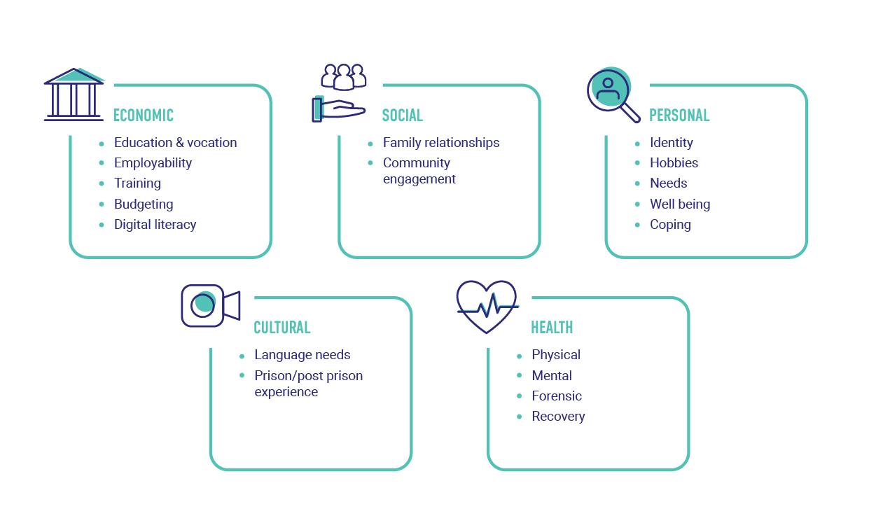
Digital rehabilitation model
UNICRI with Knight, V. & Ross, S (2024) Digital Rehabilitation in Prisons UNICRI research report, UN
https://unicri.it/News-Digital-Rehabilitation-Prisons 14th March 2024
www.europris.org
Notes:
Digital rehabilitation aims to help individuals change criminal behaviour and lead fulfilling lives, emphasising strong community and family connections. It includes education, vocational training, and programmes addressing causes of offending like substance abuse and violence. Supporting positive life changes, maintaining family contact, and easing the transition from prison to community are also vital.
Finland’s Smart prison approach is one good example of where staff were heavily involved in the design and development of the digital resources created for prisoners. Moreover staff continue to be an important stakeholder in the impact of prisoners using digital resources, as well as adapting to the DORIS system in which both staff and prisoners can interact. Therefore the by product of this intiative has created a digital community.
Digital skills are crucial for community integration, so rehabilitation must equip prisoners with these competencies. The model by Reisdorf and Rickard links rehabilitation theory with digital inequality, highlighting how digital tools can address economic, social, personal, cultural, and health issues for successful reintegration.

Slide 7

Your thoughts…
What role do staff play in this vision of digital rehabilitation?
www.europris.org
Notes:
Menti question…
Word cloud….

Slide 8

Digital rehabilitation pathways
3 potential pathways
Transformational
Enhanced- what you do
Adaptive- what you have
No single blueprint
Importance of staff – training, skills, attitudes
UNICRI with Knight, V. & Ross, S (2024) Digital Rehabilitation in Prisons UNICRI research report, UN
https://unicri.it/News-Digital-Rehabilitation-Prisons 14th March 2024
www.europris.org
Notes:
No strategy is better than the other. Fundamentally this is about meeting needs of humans. BUT staff training is key to ALL of these pathways.
Transformational pathways
Transformational pathways involve a fundamental reconceptualisation of how rehabilitation can work in prisons, combined with an investment in the digital resources required to give prisoners access to a wide range of self-help and rehabilitative interventions. This approach envisions transforming prisons into environments that foster learning and growth, through the support of digital tools accessible directly within their cells.
Enhanced rehabilitation pathways
A second development pathway involves adopting digital rehabilitation as an adjunct or supplement to existing rehabilitative activities. Digitally enhanced rehabilitation pathways build on the strengths of existing programmes and use the affordances of digital technology to increase the delivery, flexibility, accessibility, or effectiveness of those rehabilitative techniques. This pathway is most clearly evident in the way that digital education and vocational training has been used to enhance more traditional classroom forms of learning and can also be seen in the way that digital treatment and behaviour change applications are used to supplement face-to-face modes of service delivery.
Adaptive pathways
Not all digital rehabilitation pathways need to involve large investments or highly complex or specialised applications and technology. Many involve relatively simple adaptations of available digital technology to support rehabilitative activity. Probably the most frequently used element in prisons’ response to the COVID-19 pandemic was standard video-conferencing software. The necessity to establish virtual channels for professional and family contact in a very short timeframe meant that prison authorities were obliged to seek a solution that could be implemented quickly and with minimal investment in technology. Adaptive pathways can also be appropriate where the goal is to provide services to people who do not have access to specialised technologies.

Slide 9


Moral Duty & Ethical Principles
MORAL DUTY:
Prepare- citizens for re-entry
Normal- permit routine, everyday experiences
Human Right- protect the interests of humans
Harmful to deprive- eradicate pain
Restorative- create therapeutic and nourishing experiences
ETHICAL PRINCIPLES:
Legal
Privacy and transparency
Normality
Equality and fairness
Proportionality
Agency
Knight, V. & Van De Steene, S. (2020) The digital prison: Towards an ethics of technology. In: Birch, P., Sicard, L. (Eds.) Prisons and Community Corrections. London: Routledge
www.europris.org
Notes:
Principles of Digital Rehabilitation:
1. **Human Rights and Legal Principles:**
- Ensure digitisation respects legal frameworks.
- AI should not overtake human decision-making without clear laws.
- Privacy and transparency are crucial in data use and AI programming.
- Moral reasoning and data protection must be transparent.
2. **Normality:**
- Introducing normality in prisons can reduce incidents and recidivism.
- McDougall et al. found positive outcomes from normalising environments.
3. **Equality and Fairness:**
- Address the digital divide to ensure equal access.
- Proportional data usage, considering consent and long-term impacts.
4. **Proportionality:**
- Maintain proportional data retention and usage.
- Prevent misuse of data similar to credit checks.
5. **Restorative Principles:**
- Enhance agency, choice, and autonomy within restrictions.
- Ensure fair and equal access to digital tools and education.
6. **Flourishing Agency:**
- Promote flourishing through equal opportunities.
- Protect data and ensure actions remain lawful.

Slide 10

Your thoughts….
What is the role of staff in digital transformation of prisons?
What is or might be the impact of digital on staff practices/work?
www.europris.org
Notes:
Menti questions
Word cloud….

Slide 11




Staff Role in Rehabilitation (with digital)
Positive Attitudes & Understanding:
  Ensure staff buy-in and understanding of rehabilitative goals.
Training & Development:
  Address digital skills gaps with targeted training.
Specialised Skills:
  Recruit and train staff in digital tools.
Impact on Interaction:
  Digital systems may alter staff-prisoner dynamics.
Security & Risk Management:
  Equip staff to handle new security challenges.
www.europris.org
Notes:
How can penitentiary education for staff include these- workshop?

Slide 12
What we know is needed
Staff Involvement Essential: for successful digital change; requires engagement, training, and resources- co-creation.
Limited Digital Resource: Both staff and prisoners often lack access and knowledge.
Confidence and Professional Growth: Staff must be confident with digital tools; digital resources boost professional development.
Trust and Attitude: Positive staff attitudes and trust are key for a supportive digital culture.
Leadership Influence: Leaders are crucial in promoting digital adoption.
Ongoing Training: Continuous professional development (CPD) is vital; examples from the Czech Republic and Ireland show successful digital learning integration.
Specialised Training Needs: Early and specialised training is important, especially for sensitive areas like elderly prisoner care.
UNICRI with Knight, V. & Ross, S (2024) Digital Rehabilitation in Prisons UNICRI research report, UN
https://unicri.it/News-Digital-Rehabilitation-Prisons 14th March 2024
www.europris.org
Notes:
Staff are crucial in implementing digital change in prisons, requiring active engagement, training, and resource provision. Like prisoners, staff often face limited access to digital resources and lack knowledge about their benefits and risks. For digital rehabilitation to succeed, staff must be confident in using digital tools, understand their role in supporting rehabilitation, and see the professional development benefits.
Positive staff attitudes towards digital adoption are essential, as they influence the prison culture and the success of digital initiatives. However, trust must be built, particularly in security and practical challenges, for successful technology integration. Leadership plays a key role in promoting the benefits of digital tools, especially in enhancing rehabilitation, communication, and safety.
Continuing Professional Development (CPD) is vital for staff expertise and job satisfaction. Countries like the Czech Republic and Ireland have successfully implemented digital learning for prisoners and staff, fostering ongoing learning and adapting to changing needs. Specialised training, including e-learning, gamification, and online communities, supports diverse staff roles and improves outcomes, especially in areas like elderly prisoner care. However, some staff prefer face-to-face interaction for applying knowledge, particularly on sensitive issues. Early training in specialised prison careers is also needed.
Staff are crucial in implementing digital change in prisons, requiring active engagement, training, and resource provision. Like prisoners, staff often face limited access to digital resources and lack knowledge about their benefits and risks. For digital rehabilitation to succeed, staff must be confident in using digital tools, understand their role in supporting rehabilitation, and see the professional development benefits.
Positive staff attitudes towards digital adoption are essential, as they influence the prison culture and the success of digital initiatives. However, trust must be built, particularly in security and practical challenges, for successful technology integration. Leadership plays a key role in promoting the benefits of digital tools, especially in enhancing rehabilitation, communication, and safety.
Continuing Professional Development (CPD) is vital for staff expertise and job satisfaction. Countries like the Czech Republic and Ireland have successfully implemented digital learning for prisoners and staff, fostering ongoing learning and adapting to changing needs. Specialised training, including e-learning, gamification, and online communities, supports diverse staff roles and improves outcomes, especially in areas like elderly prisoner care. However, some staff prefer face-to-face interaction for applying knowledge, particularly on sensitive issues. Early training in specialised prison careers is also needed.

Slide 13
What is needed to leverage staff digital education?
Timing of Training: Encourage digital change acceptance and tailored training for both new and experienced staff.
Participant Selection: Ensure fair, inclusive, and unbiased access to digital training.
Feedback from Prisoners: Use prisoner feedback to enhance training quality and effectiveness.
Accreditation & Quality Assurance: Ensure digital training is accredited and meets evolving standards.
Post-Training Support: Provide ongoing support, including mentorship and peer networks.
Practice Challenges: Use digital tools to address real-world scenarios and practical challenges
UNICRI with Knight, V. & Ross, S (2024) Digital Rehabilitation in Prisons UNICRI research report, UN
https://unicri.it/News-Digital-Rehabilitation-Prisons 14th March 2024
www.europris.org
Notes:
Timing of Training: • Encourage staff to accept digital change and create meaningful engagement with digital rehabilitation. Brokering co-creative modes of consultation is crucial to a normalize digital culture. • Consider the critical factor of timing in training prison officers. Leverage digital learning to tailor training for specific needs, providing comprehensive fundamentals for new recruits as well as continuous professional development for established staff.
Participant Selection: • Address the unique challenge of participant selection for training programmes. • Mitigate potential biases by ensuring fair and inclusive opportunities. • Utilise digital learning to provide standardised access to training modules, promoting an unbiased approach to participant selection.
Feedback from Prisoners on Training Quality: • Enhance training quality by seeking feedback from incarcerated individuals who directly interact with prison officers. • Incorporate prisoner perspectives to gain insights into the effectiveness of training in improving relationships, communication, and overall facility conditions. • Integrate mechanisms for prisoner feedback into digital training programmes for continuous improvement.
Accreditation and Quality Assurance: • Subject digital training for prison officers to rigorous accreditation and quality assurance processes. • Obtain accreditation from relevant authorities, such as justice agencies or educational institutions, to validate content and delivery. • Continually assess and update approvals and quality standards to meet evolving requirements.
Post-Training Support: • Acknowledge that training extends beyond completing digital modules. • Provide crucial post-training support to ensure effective application of newly acquired knowledge. • Establish peer support networks, mentorship programmes, and access to additional resources as integral components of the overall training strategy. • Utilise digitally enabled networks for ongoing communication and reflection.
Practice Challenges: • Embrace digital learning to address real-world scenarios and practical challenges faced by prison officers. • Implement interactive simulations, case studies, and scenario-based training to bridge the gap between theory and practice. • Prepare officers for complex issues, such as managing aging or terminally ill prisoners, foster empathy and professionalism in their approach

Slide 14
Your thoughts…
What kind of staff need to be recruited for the modern prison?
www.europris.org
Notes:
Menti question…
Word cloud….

Slide 15

Staff as Brokers in Prison Reform
Partnerships- in and between agencies
Co-creation of training
Sustainability
Shared vision- with digital as a resource/ normalised
Leaders with strong change management acumen
Involvement in evidence and reporting training outcomes/experiences
www.europris.org
Notes:
Menti question…
Word cloud….

Slide 16

Preparation for workshop
Show case examples of digital staff training and resources
Work in groups- each group will focus on specific topics
Feedback and sharing of good practice/ideas
Collective action- what next- what priorities
www.europris.org

Slide 17
THANK YOU!
მადლობა (Madloba)
www.europris.org

